Slide 1

Introduction to MongoDB
Poo Kuan Hoong

Slide 2
Learning Objectives
Basic understanding of the concept of NoSQL
Introduction to MongoDB, MongoDB Shell, MongoDB Compass and MongoDB Atlas
Basic CRUD Operations
Accessing MongoDB via Python - PyMongo

Slide 3
No SQL
Not Only SQL
Non-relational database
With Big Data, there is a need to support storing and querying huge amounts in the form of structured and unstructured data
No SQL databases provide:
Scalability
Cost
Flexibility
Availability
Notes:
Got no pre-defined schema like SQL
No-SQL – not only SQL
Doesn’t have:
Consistency
security

Slide 4
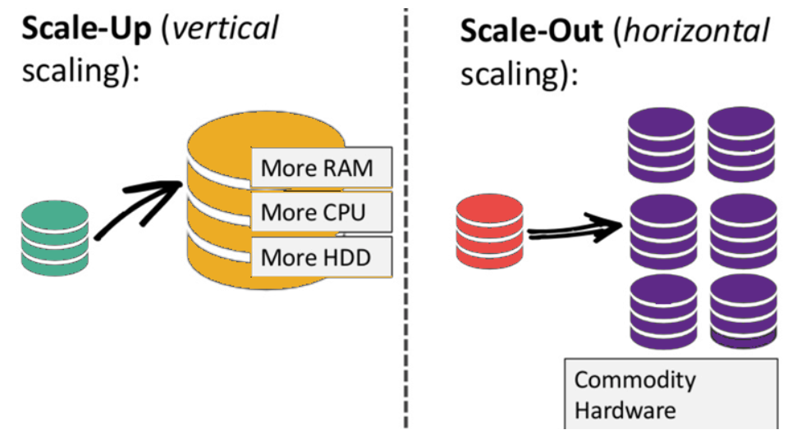
Advantages of NoSQL vs RDBMS
Can handle semi-structured and unstructured data
No predefined schema
Scaling - Scaling out/ Horizontal Scaling
Less overheads
Avoid the complexity of SQL queries
Notes:
Scaling up vs scaling out
This case, we talk about scaling out
Less overheard – less resources

Slide 5
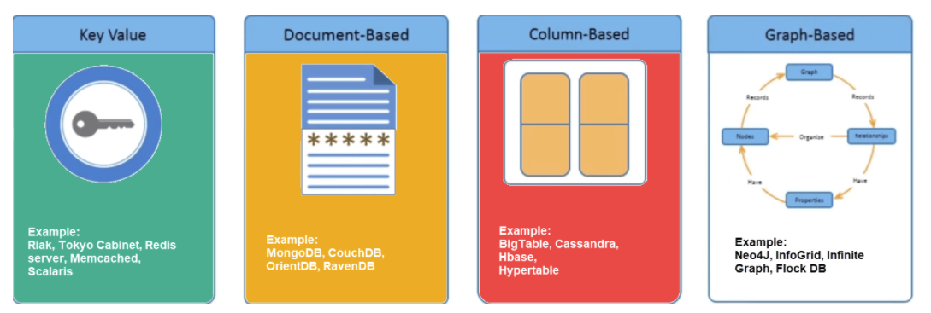
NoSQL Types
It can be classified into 4 types:
Key-value pair based – Redis, Oracle NoSQL
Column based – Apache Cassandra, Hbase, BigTable, DynamoDB
Document based - MongoDB
Graph based – Neo4J

Slide 6
Key-Value Pair Based
Data Model: (key, value) pairs
Designed for processing dictionary
Dictionaries contain a collection of records having fields containing data
Records are stored and retrieved using a key that uniquely identifies the record and is used to quickly find the data within the database
Example: Oracle NoSQL, Riak etc
Use it for storing session information, user profiles, preferences and shopping cart data

Slide 7
Column Based
It stores data as Column families containing rows that have many columns associated with a row key. Each row can have different columns
Columns families are groups of related data that is accessed together
Example: Cassandra (Facebook), HBase, Hyptertable and Amazon DynamoDB
Use it for content management system, blogging, platform, log aggregation

Slide 8
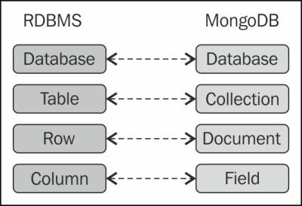
Document Based
The database store send retrieves documents, It stores document in the value part of the key-value store
Self describing hierarchical tree data structures consisting of maps, collections and scalar valued
Example: MongoDB, Couch DB,
Use it for content management systems, blogging platforms, web analytics, real time analytics, e-commerce applications
Notes:
What we gonna learn today : mongodb

Slide 9
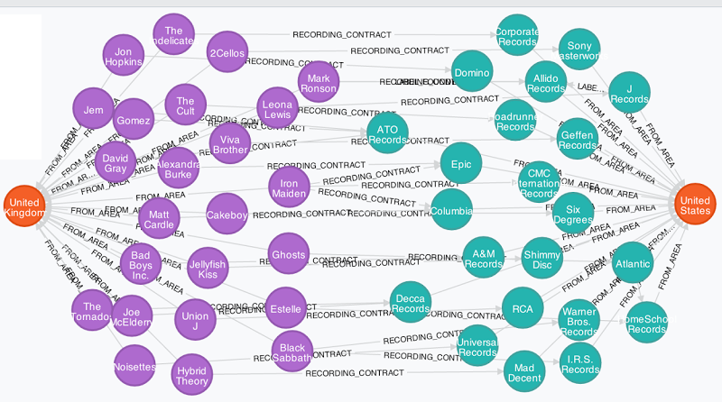
Graph Based
Store entities and relationships between these entities as nodes and edges of a graph respectively. Entities have properties.
Traversing the relationships is very fast as relationship between nodes is not calculated at query time but is actually persisted as a relationship
Example: Neo4J, InfiniteGraph
Well suited for connected data such as social networks, spatial data, routing information for goods and supply
Notes:
Suitable for social network, social connections (tracking covid)

Slide 10

Quiz 1
https://forms.office.com/Pages/ResponsePage.aspx?id=DQSIkWdsW0yxEjajBLZtrQAAAAAAAAAAAAEjV0wuf3JURUhXQ0ozVkwxNlYyN0JaNzg0TVdESkROMS4u

Slide 11
Introduction: MongoDB
MongoDB is a No SQL Database
MongoDB stores data in the form of Document
Documents will be stored as collection in MongoDB
MongoDB can be assessed via the cloud or local premise
https://www.mongodb.com/

Slide 12
Introduction: MongoDB
MongoDB stores data in the form of documents, which are JavaScript Object Notation (JSON) like field and value pairs
JSON Syntax Example:
{ application: “HR System”,
user: [
{name: “Kate”,
age: 35
},
{name: “Jack”,
age: 42
}
]}
Value
Field

Slide 13
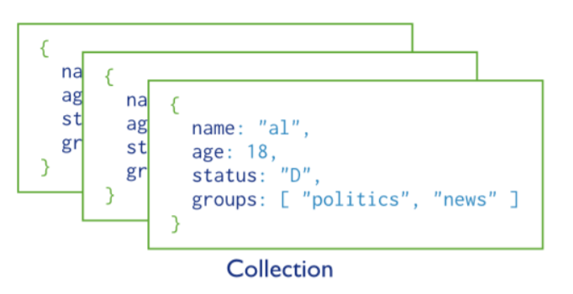
Introduction: MongoDB
MongoDB stores all documents in collections.
A collection is a group of related documents that have a set of shared common indexes.
Collections are analogous to a table in relational databases.

Slide 14
Document
A way to organize and store data as a set of field-value pairs
{
<field> : <value>,
<field> : <value>,
“name” : “Ahmad”,
“title” : “team lead”,
“age” : “26”
}

Slide 15
Collection
An organized store of documents in MongoDB, usually with common fields between documents
{
“name” : “Ahmad”,
“title” : “team lead”,
“age” : “26”
}
{
“name” : “Lee”,
“title” : “developer”,
“age” : “25”
}
{
“name” : “Arul”,
“title” : “designer”,
“age” : “24”
}

Slide 16
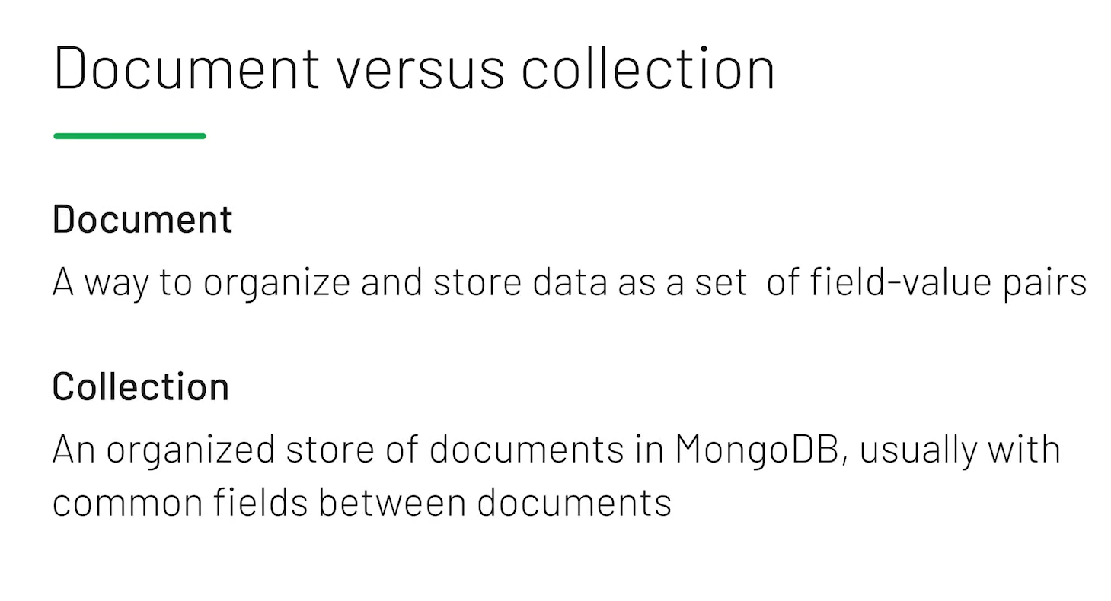
Notes:
Try at least have common field in the document (possible to not have similar pair too btw)

Slide 17
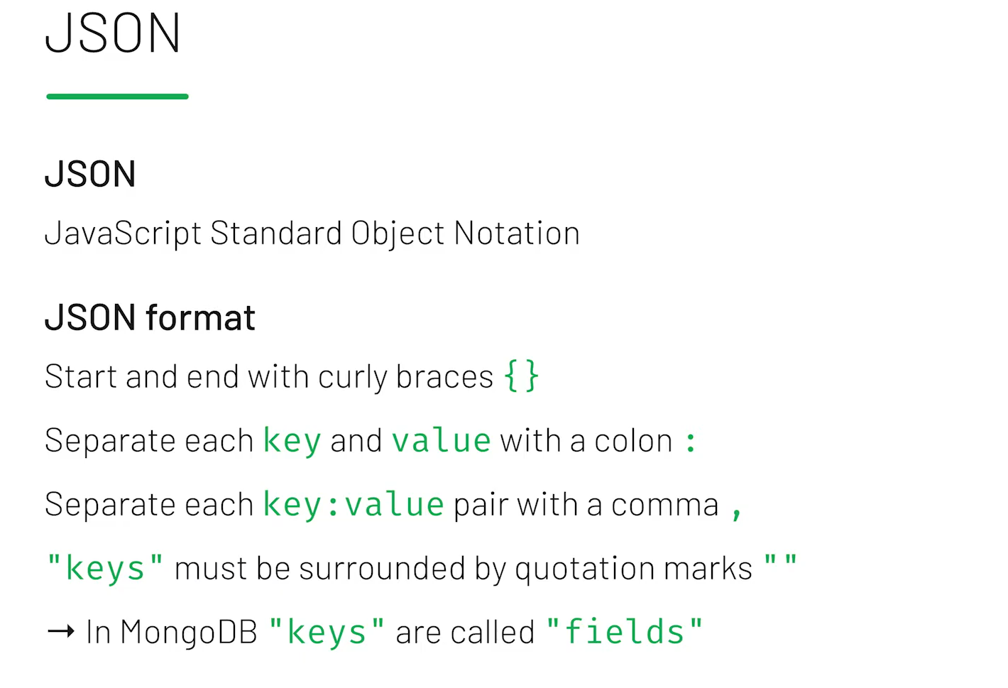

Slide 18
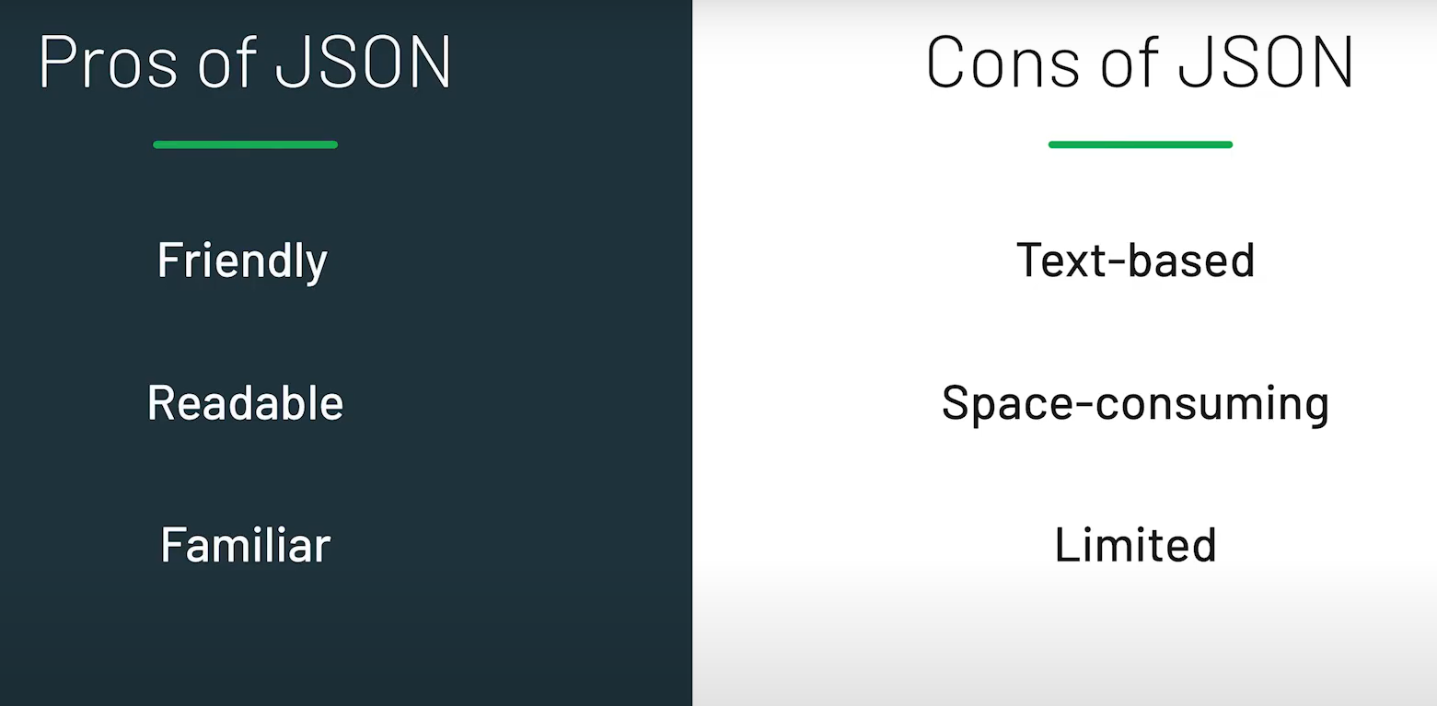

Slide 19
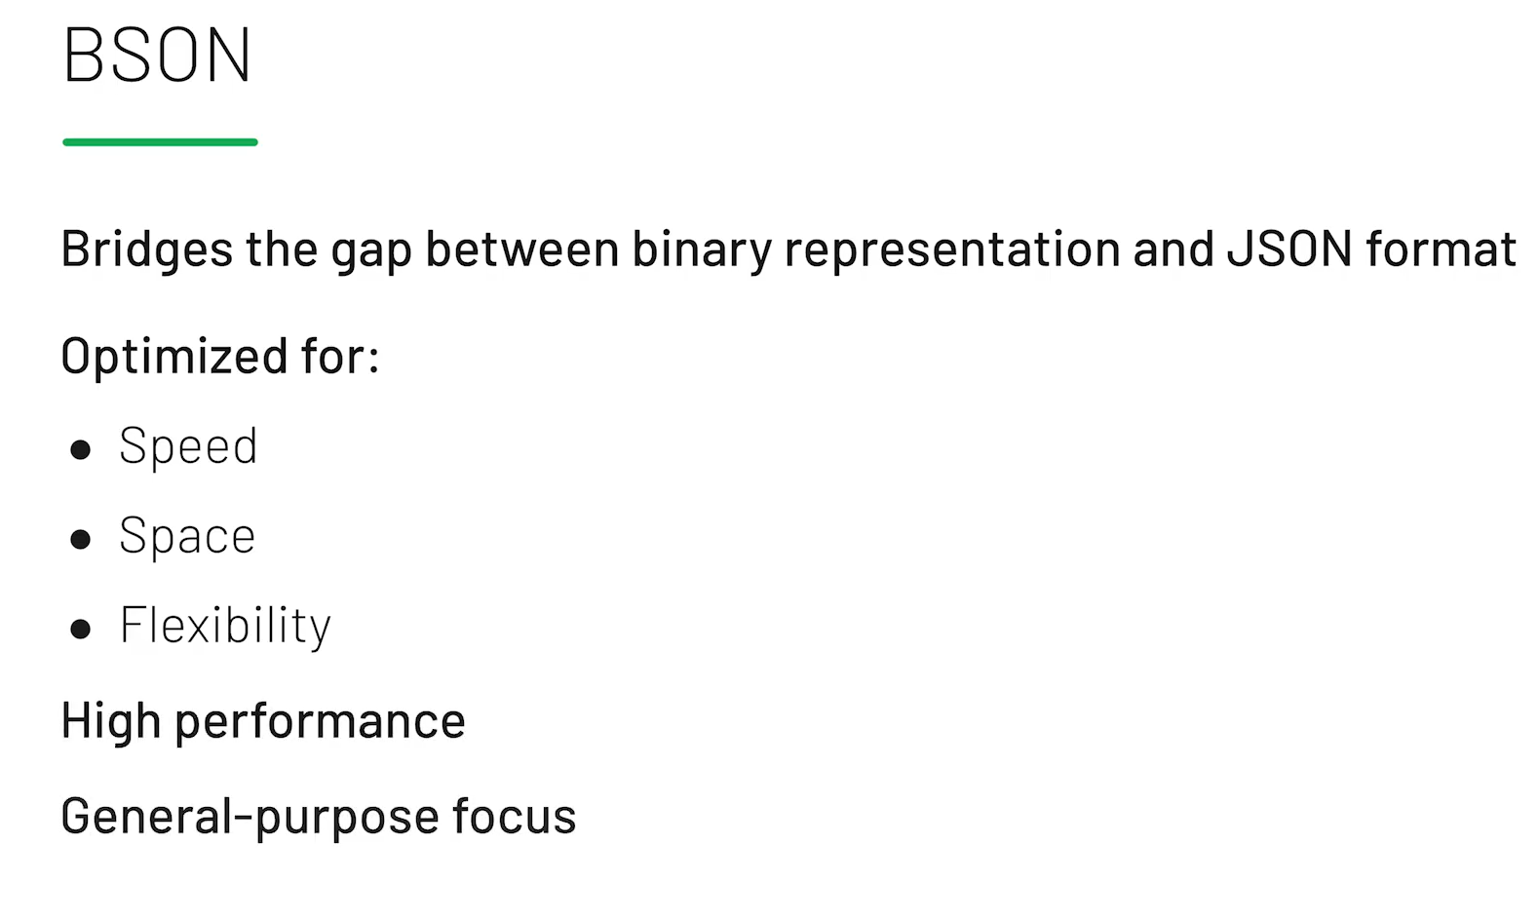
Notes:
Bson – Binary JSON
Format similar to json, but binary format

Slide 20
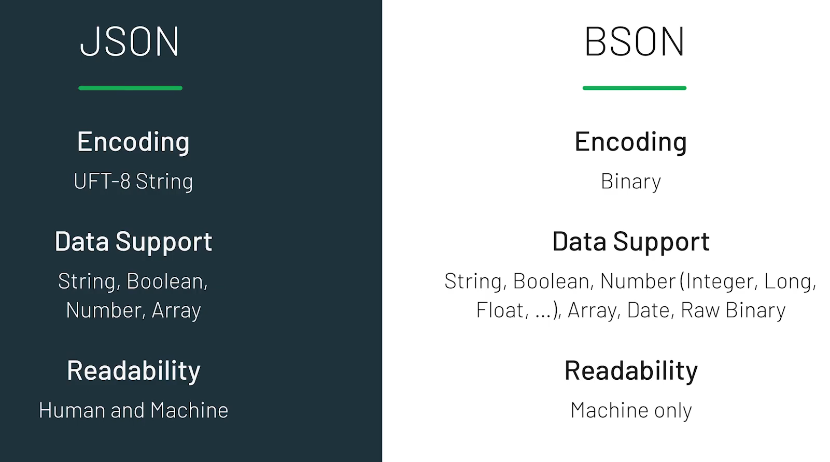
Notes:
Coz only machine readable – faster and smaller

Slide 21
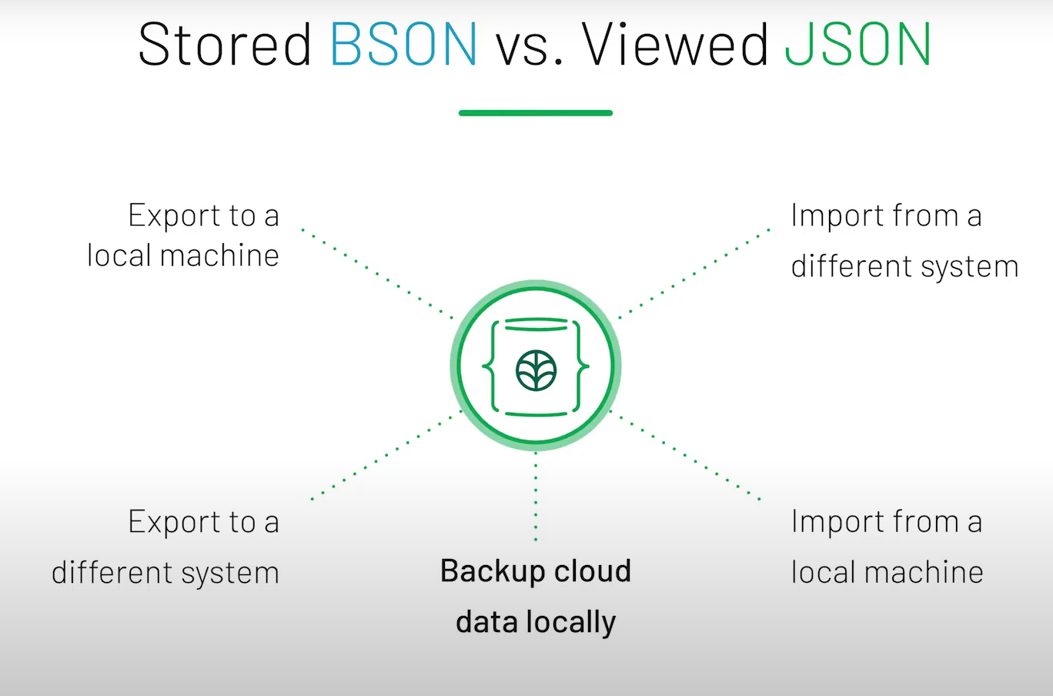
Notes:
Stored in BSON
Viewed in JSON
Can import and export from/to BSON/JSON

Slide 22
Introduction to CRUD
Create
insert ()
Read
find ()
Update
update ()
Delete
remove ()
Notes:
These command is the command in mongoDB

Slide 23
Quiz 2
https://forms.office.com/Pages/ResponsePage.aspx?id=DQSIkWdsW0yxEjajBLZtrQAAAAAAAAAAAAEjV0wuf3JUN0JVMEVSTTExMDRGS1oyNjZLVFZNSTU3QS4u

Slide 24
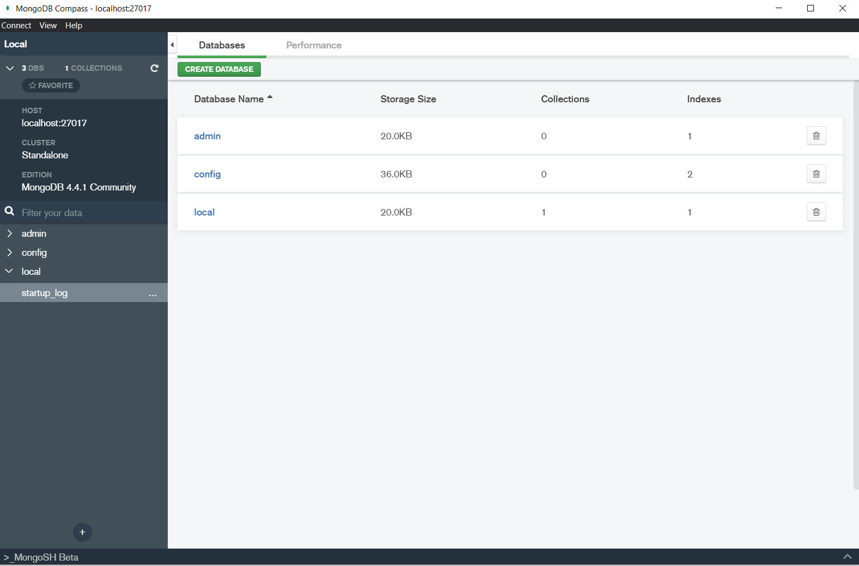
Creating a new Database
In the MongoDB Compass environment, you can see databases.
Click on the “Create Database” button.
Name your new database – “Class”

Slide 25
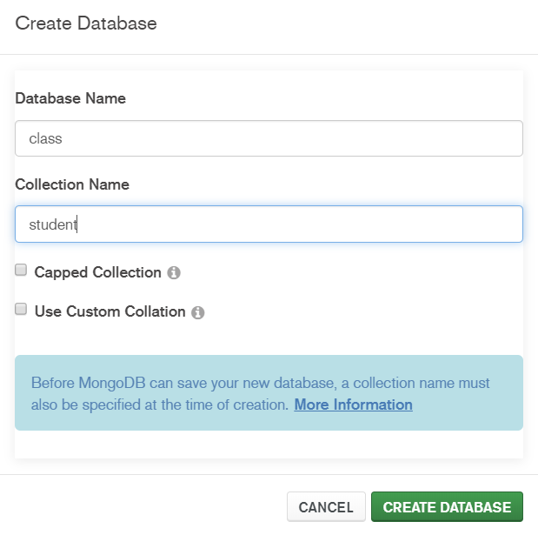
Creating Collection
We have already created our database now it’s time to create our collection.
MongoDB will automatically create collection if it’s not been created. Else, MongoDB will insert the record in the existing collection.
Methods:
Expand the database and right click on Collections. Then, choose Create Collection.
Name the collection as ‘Student’ and click ‘Create’

Slide 26
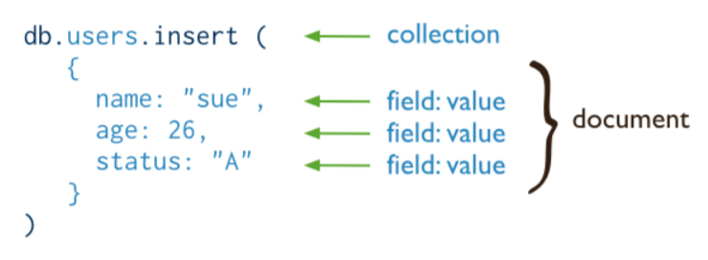
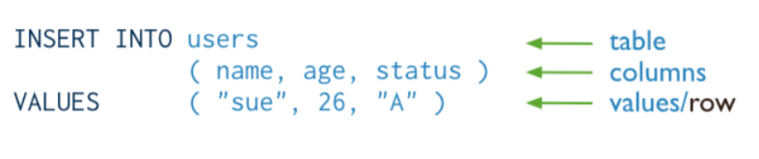
MongoDB
MongoDB
Relational Database

Slide 27
ObjectID
We do not need to provide _id for any documents but MongoDB automatically create unique _id for each document inserted.
"_id":ObjectId("56c2f6119d1f4f37a06823fc")
When we insert a document in MongoDB, server requires that all documents is uniquely identified using an _id.
The _id field is the primary key.
ObjectId will be constructed using:
current time, identifier for the machine that constructing the ObjectId, the process id of the process

Slide 28
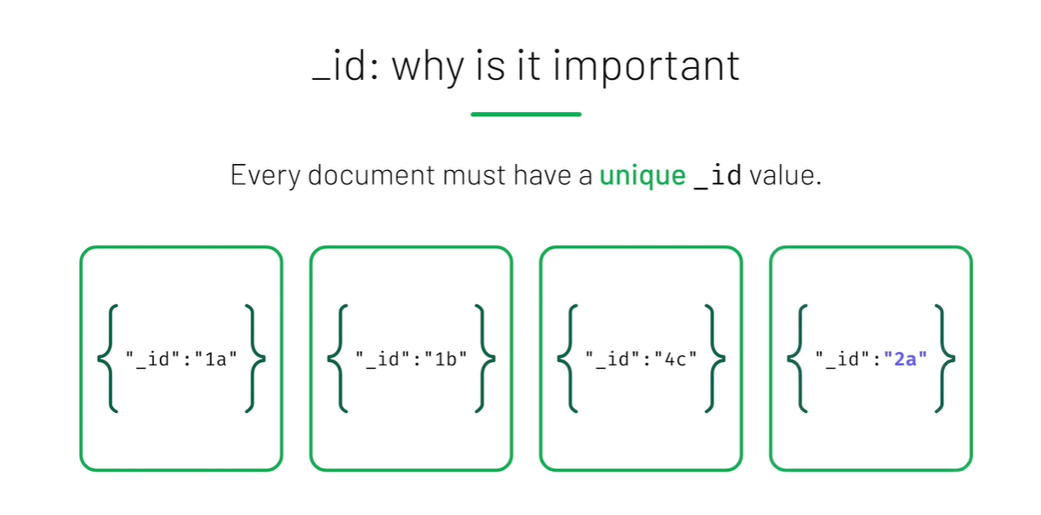

Slide 29
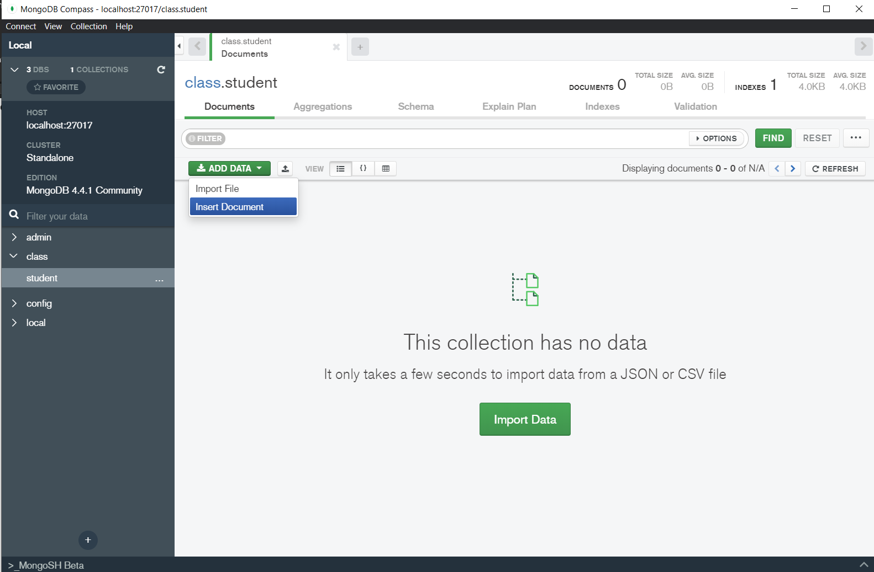
Inserting Document
On MongoDB Compass, a document can be inserted by using the MongoDB Shell at the bottom left or using the “Add Data” and click the “Import File” or “Import Document” button.
Data can be imported from JSON or CSV formats

Slide 30
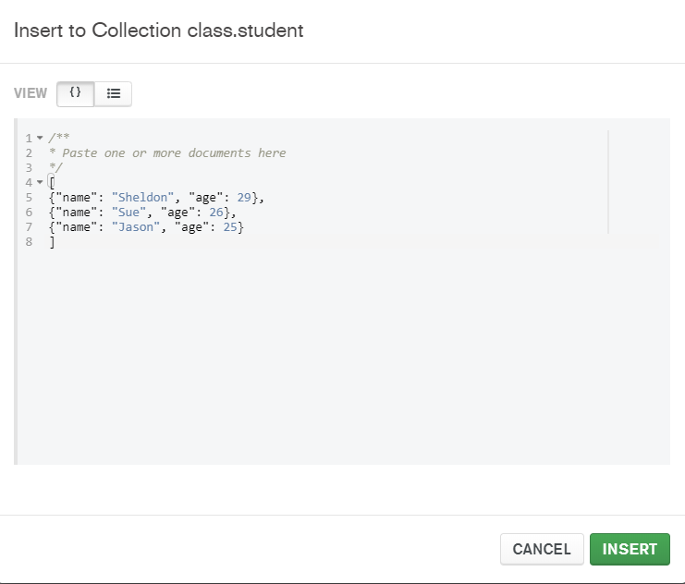
Inserting Document (cont’d)
Use the “Insert Document” to insert multiple collections at one time.

Slide 31
CRUD Operations
C
insert ()
√
R
find ()
U
update ()
D
remove ()

Slide 32
Finding Document
In SQL, we use SELECT to query the database.
In MongoDB, we use find()
SQL | MongoDB
SELECT * FROM Student; | db.Student.find()

Slide 33
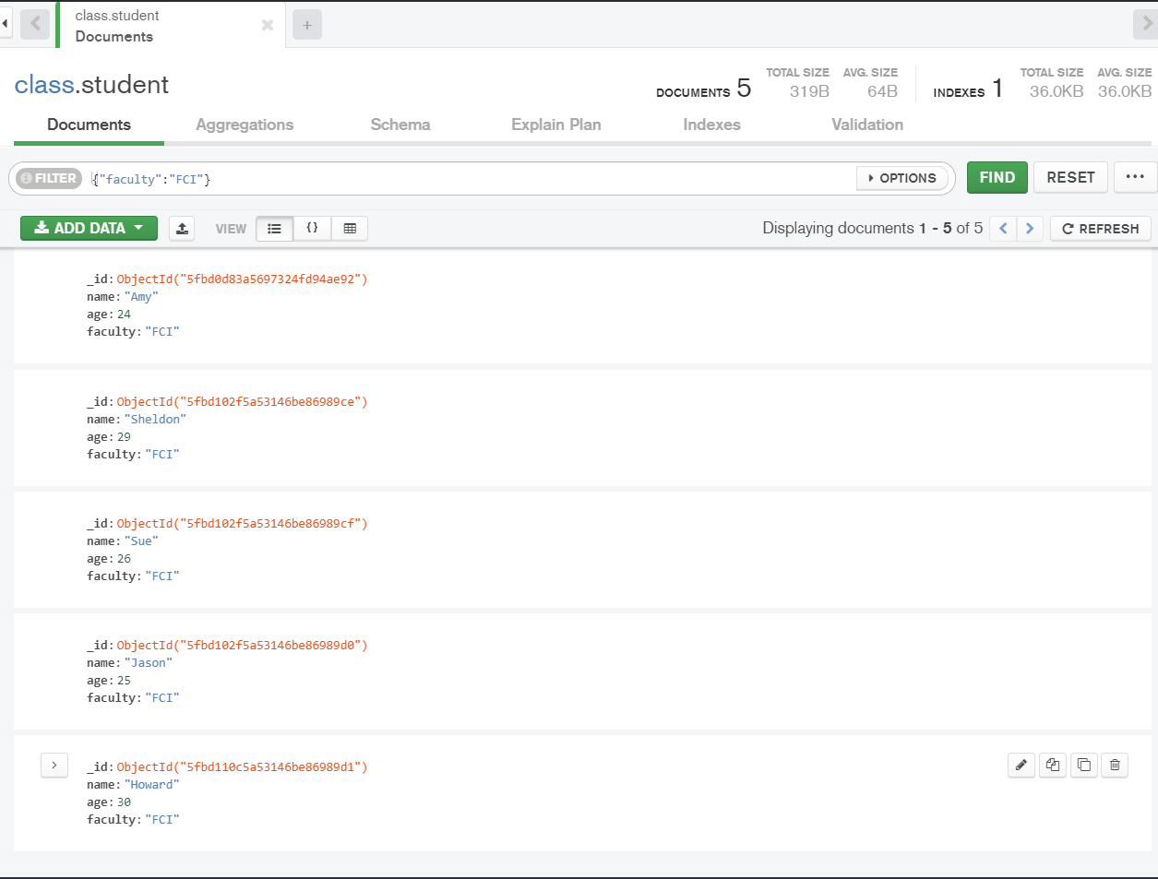
Finding Document (cont’d)
Notes:
In mongo compass

Slide 34
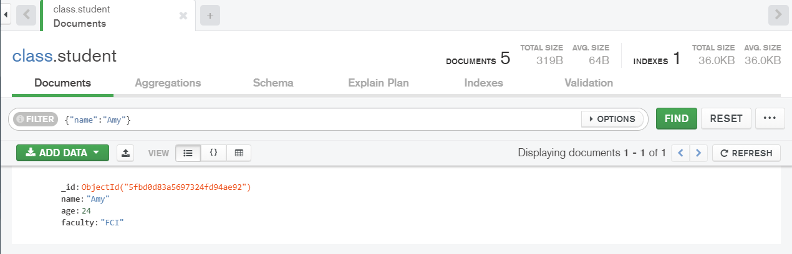
Finding Document (cont’d)
Limit the search results using equality condition
SQL | MongoDB
SELECT * FROM Student WHERE StudName = “Thomas”; | db.Student.find({StudName: "Thomas"})

Slide 35
Finding Document (cont’d)
Finding documents with logical query operators - AND and OR
db.Student.find({$and:[{StudName: "Thomas"},
{StudID: "A104"}]})
db.Student.find({$or:[{StudName : "Thomas"},
StudName: "Kanesan"}]})
Notes:
All operator start with $

Slide 36
Finding Document (cont’d)
Finding documents with comparison query operators:
Greater than $gt
Greater than equal $gte
Less than $lt
Less than equal $lte
Not equal $ne
db.Student.find({Final: {$gt: 50}})

Slide 37

Activity
Let’s examine the following commands. For each command,
Explain the purpose of the query
Execute the command in MongoDB Compass. How many documents are returned?
db.Student.find({Final: {$gte: 50}})
db.Student.find({Final: {$lt: 50}})
db.Student.find({Final: {$ne: 50}})
db.Student.find({$and: [{Final: {$gte: 70}},{Final: {$lt: 80}}]})
db.Student.find({StudName: {$ne: "Thomas"}})
db.Student.find({$or: [{Final: {$lt: 50}}, {StudName: {$ne: "Thomas"}}] })

Slide 38
Finding Document (cont’d)
We can use IN for checking values of the same field
db.Student.find({StudName: {$in: ["Thomas", "Kanesan"]}})
Use aggregate() to perform aggregation operations:
$sum returns the summation value
$avg returns the average value
$max returns the maximum value
$min returns the minimum value

Slide 39
Finding Document (cont’d)
Get the highest final mark in all documents
db.Student.aggregate
([{$group: {_id: null,
highestMark: {$max: "$Final"}}
}])
$group arrange identical data into groups
_id is compulsory field. Set this to null to calculate accumulated values for all the documents as a whole

Slide 40
Finding Document (cont’d)
Get the average and minimum final mark in all documents
db.Student.aggregate
([{$group: {_id: null,
AverageMark: {$avg: "$Final" },
MinMark: {$min: "$Final" }}
}])

Slide 41
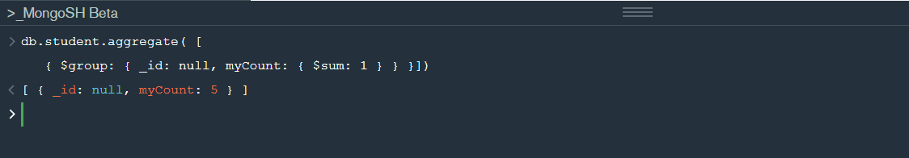
Finding Document (cont’d)
Count the number of documents (students) in a collection
db.student.aggregate([
{$group: { _id: null, myCount: {$sum: 1}}}
])

Slide 42
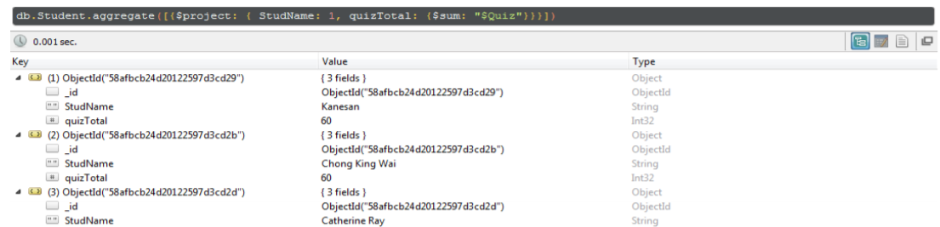
Finding Document (cont’d)
Get the name and total quiz score for each student
db.Student.aggregate
([{$project: {StudName: 1,
quizTotal: {$sum: "$Quiz"}}}])
$project select some specific fields from a collection

Slide 43
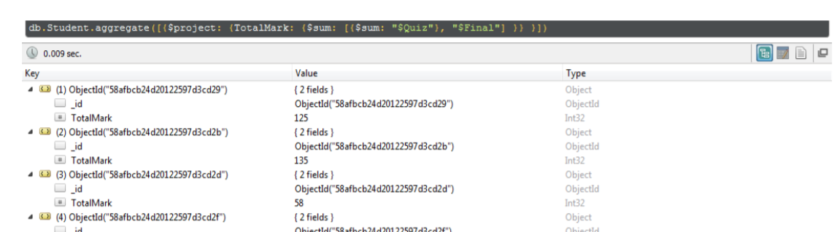
Finding Document (cont’d)
Calculate the total mark (final + quiz) for each student
db.Student.aggregate
([{$project: {TotalMark:
{$sum: [{$sum: "$Quiz"}, "$Final"]}} }])

Slide 44
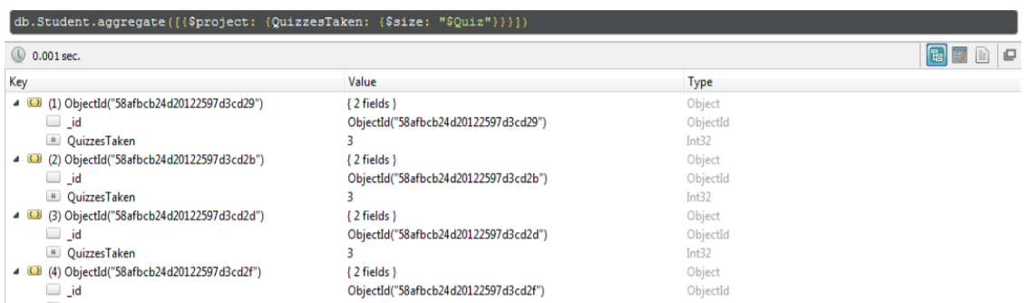
Finding Document (cont’d)
Count the number of quizzes taken by each student
db.Student.aggregate
([{$project: {QuizzesTaken:
{$size: "$Quiz"}}}])

Slide 45
CRUD Operations
C
insert ()
√
√
R
find ()
U
update ()
D
remove ()

Slide 46
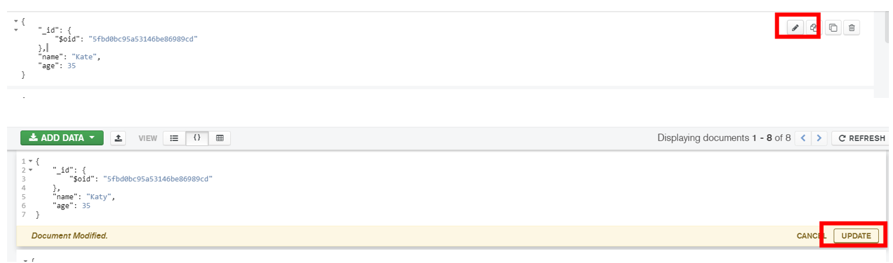
Updating document
Select the document to edit
Click at the “pencil icon” to edit
Edit the script with new value(s)
Click ‘Update’

Slide 47
Updating document (Cont’d)
The update() method is used to update the documents of a collection.
The method accepts parameters:
An update conditions document to match the documents to update,
An update operations document to specify the modification to perform, and
Options parameters.
By default, update() updates a single document. To update multiple documents, use the multi option.

Slide 48
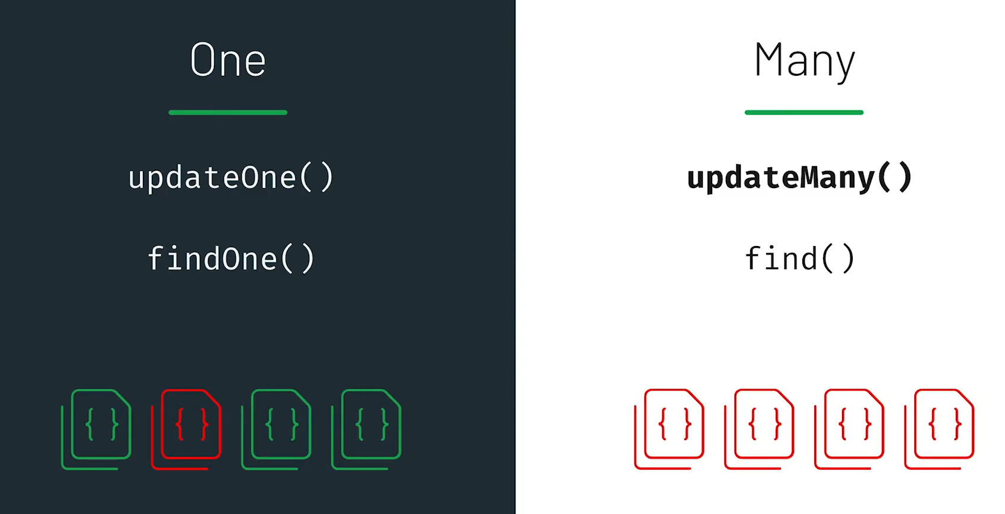

Slide 49
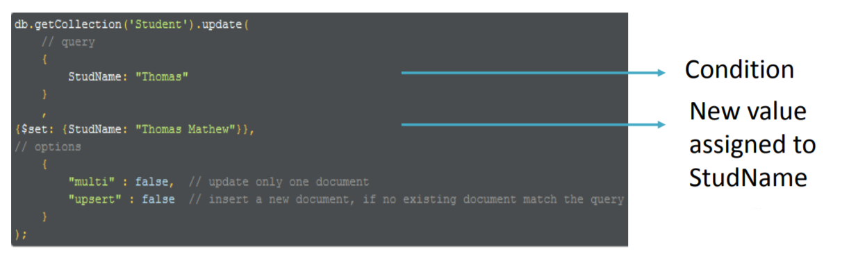
Updating document (Cont’d)
Select the document to edit
Click at the “pencil icon” to edit
Edit the script with new value(s)
Click ‘Update’
db.student.updateOne({condition},{statements})
db.student.updateMany({condition},{statements})

Slide 50
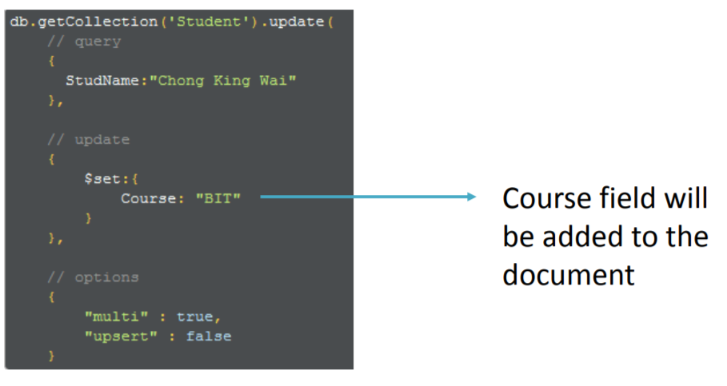
Updating document (Cont’d)
The method to add a new field into a collection is same as the previous process. If the field in the update query is not found in the document, then field will be added to the document

Slide 51
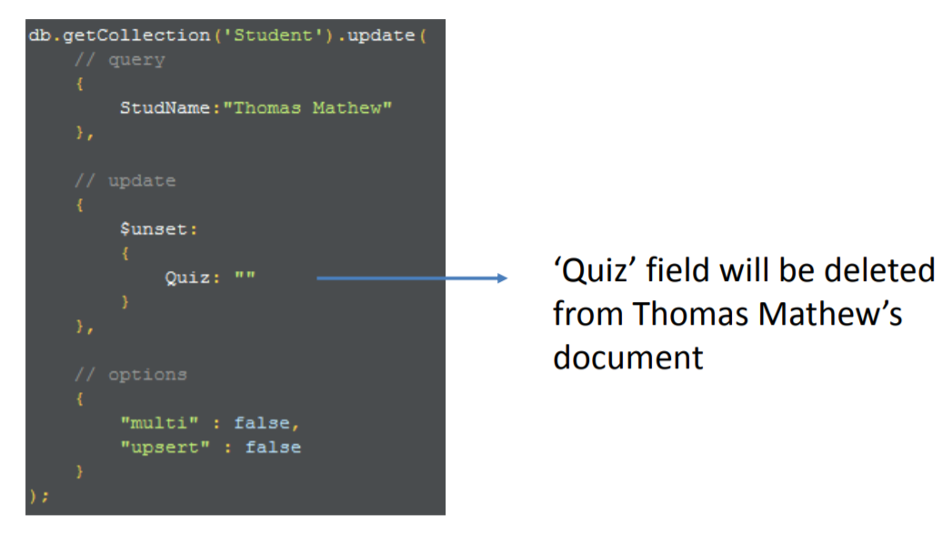
Updating document (Cont’d)
To delete a particular field in a collection: $unset
s

Slide 52
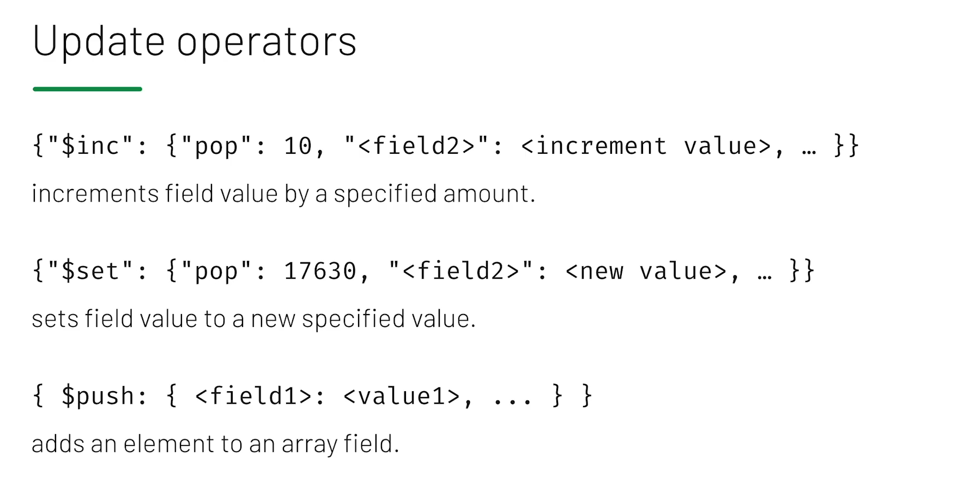
https://docs.mongodb.com/manual/reference/operator/update/#id1

Slide 53
CRUD Operations
C
√
√ √
insert ()
R
find ()
U
update ()
D
remove ()

Slide 54
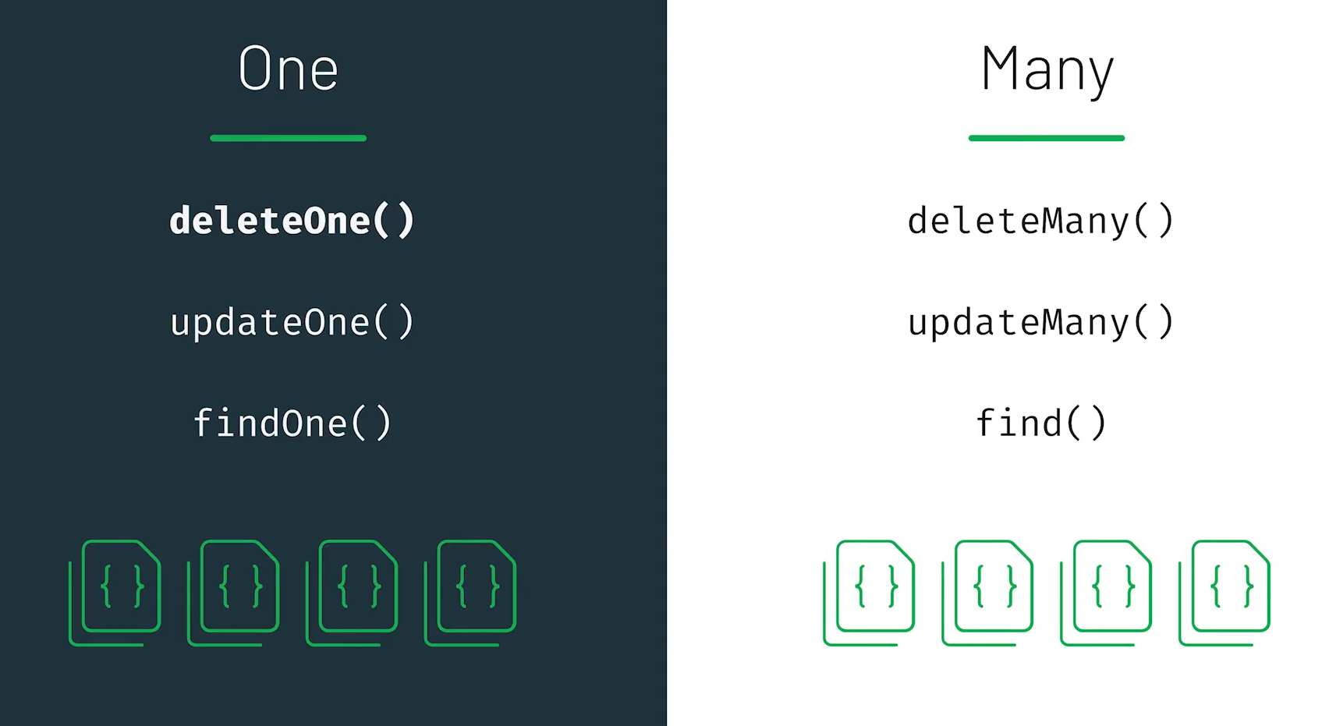

Slide 55
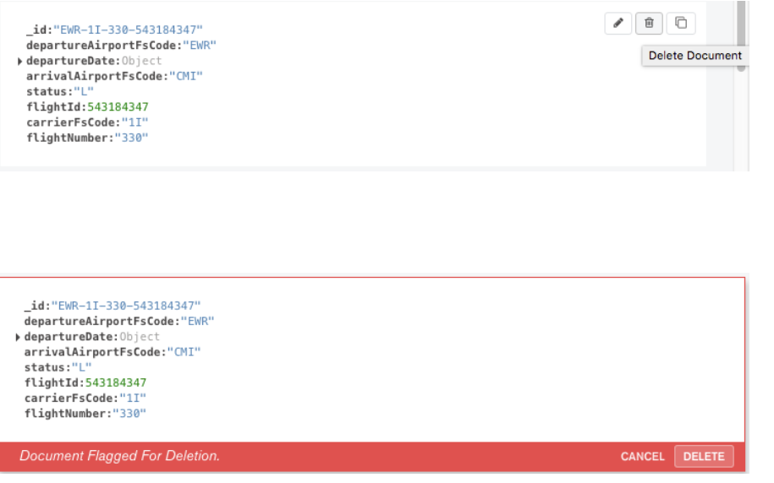
Remove Documents
Use remove() to remove a document from a collection that satisfies user’s condition
Method
To delete a document, hover over the document and click the icon.
After you click the delete button, the document is flagged for deletion. Compass asks for confirmation that you want to remove the document:
db.getCollection('Subject').remove({SubjectCode : "DPF555"});

Slide 56
Remove Documents (Cont’d)
You cannot delete multiple documents at once from the Compass UI .
As an alternative, you can use the db.collection.deleteMany() method in the embedded MongoDB Shell to delete multiple documents in a single operation.

Slide 57
CRUD Operations
C
insert ()
√
√
√
√
R
find ()
U
update ()
D
remove ()

Slide 58
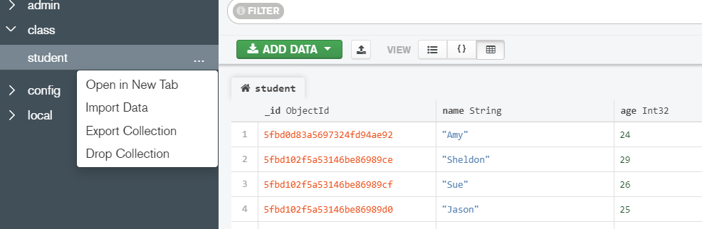
Drop a Collection from Database
Select the collection
Choose ‘Drop Collection’
Type the collection name to drop the collection.

Slide 59
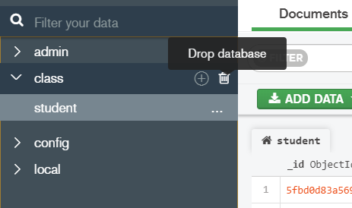
Drop a database
Similar to drop collection.

Slide 60
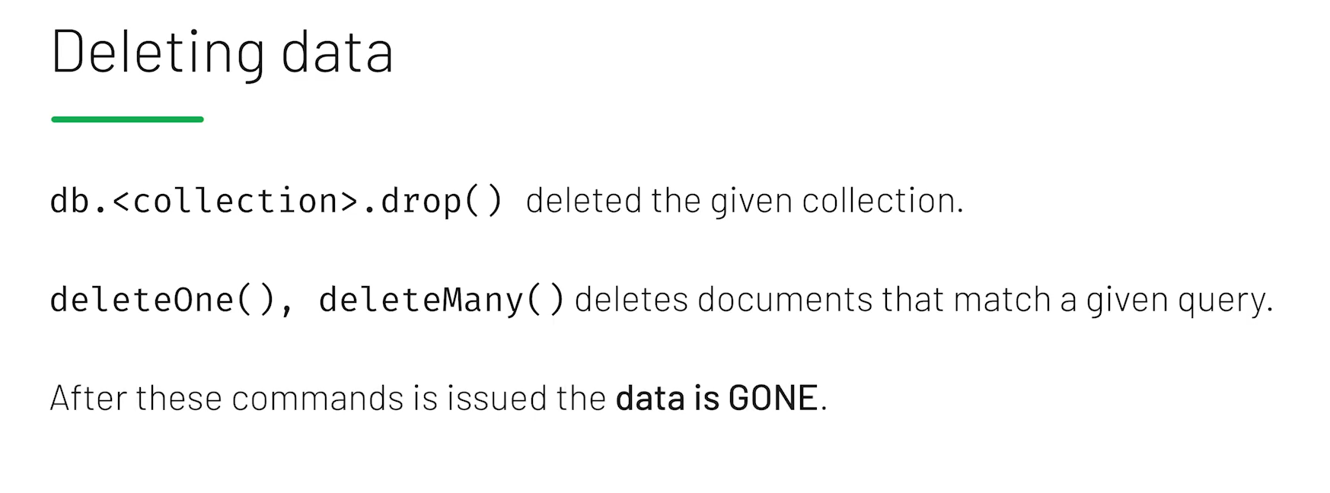

Slide 61
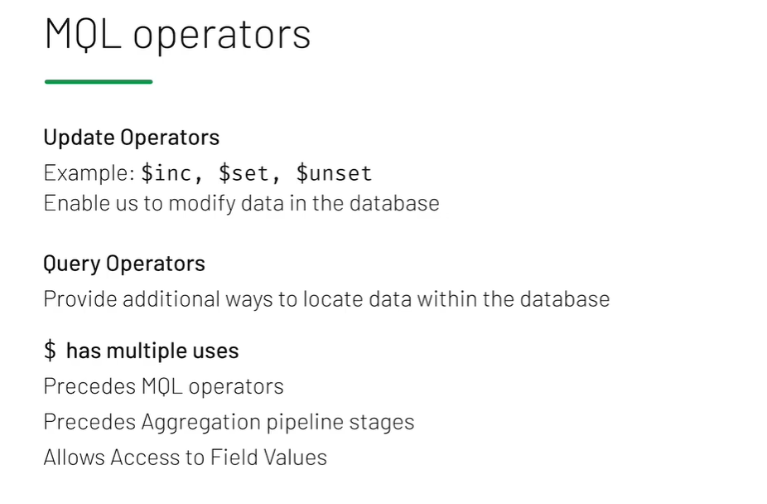

Slide 62
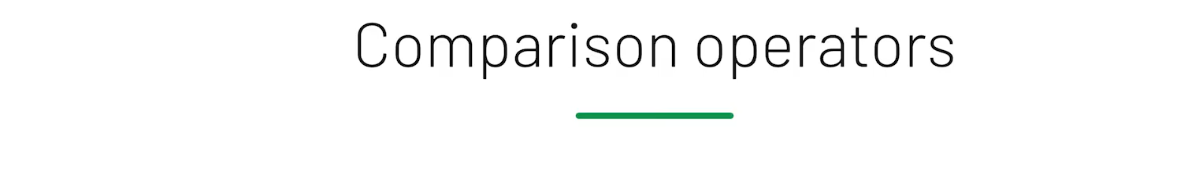
$eq = EQual to $neq = NotEQual to
$gt > Greater Than $lt < Less Than
$gte ≥ Greater Than or Equal to $lte ≤ Less Than or Equal to
{<field> : { <operator>: <value> }}

Slide 63
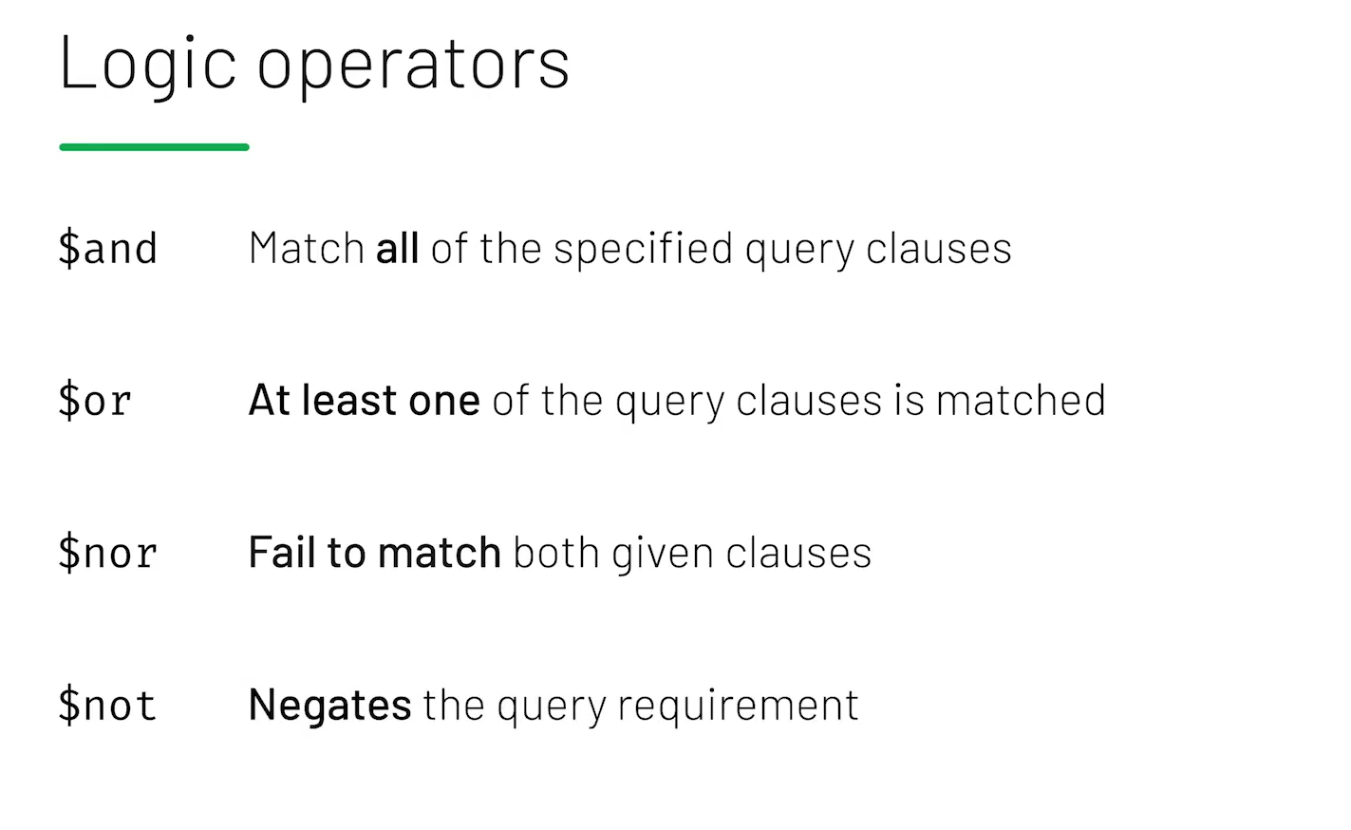

Slide 64
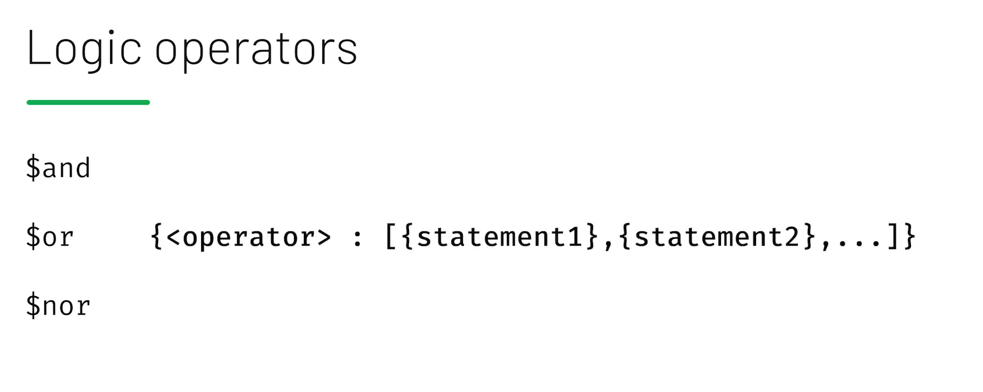


Slide 65
Quiz 3
https://forms.office.com/Pages/ResponsePage.aspx?id=DQSIkWdsW0yxEjajBLZtrQAAAAAAAAAAAAEjV0wuf3JUOTNGNExURE82Q1ZLM09UUDM5MUdMNlhHRi4u

